Slide 1
UTSA Student Branch Phase II Funding Spring 2019
IEEE Central Texas Section
January 19, 2019
San Marcos, Texas
Branch Advisor: Dr. Paul Morton - Paul.Morton@utsa.edu

Slide 2
Student Branch Overview
Largest active student engineering organization at UTSA
Integral part of College of Engineering student activities
Leadership Team: (14 officers)
Position | Name | Email Address
Chairman | Jessica Vaquera | rrm701@my.utsa.edu
Vice Chairman | Josue Alcaraz | vom101@my.utsa.edu
HKN President | Michael Palacios | hkn.utsa@gmail.com
HKN Vice President | Allen Herrera | pwj365@gmail.com
Robotics Chairman | Alexander Ibarra | robotics.utsa@gmail.com

Slide 3
Past Utilization of CTS Funding Phase I & II Funding accomplishments from 2018:
Student Interest Groups (R5 Robotics) [$800]
Social Engagement (Student Branch) [$200]

Slide 4
Branch Goals Requested amount for Phase I 2018: $1000
Region5 Robotics Competition [$500]
HKN Workshops [$200]
Robotics Automation Society Workshops [$300]

Slide 5
2018 Accomplishments
Spearheaded first ever offered FE Prep courses at UTSA
RAS had successful workshops teaching students ROS
Power & Energy Society established

Slide 6
Branch Goals Requested amount for Phase II 2018 - 2019: $1500+
Region5 Robotics Competition [$1000+]
IEEE Promotional Materials [$200+]
HKN workshops[$200]

Slide 7
Branch Goals
Region5 Conference
Compete in R5 Robotics competition
Increase student presence at conference (~25 attendees)
Increase participation in workshops with proper material and equipment
FE Workshop
Prepare students for the FE Exam
Bring speakers from industry to give insight for students.

Slide 8
Branch Goals
Establish Power Electronics Society (by request)
PES hosted SwRI energy tour with CPS + control systems tour in collaboration with UTSA professor
Hybridize general meetings to include speaker events
Host networking party in collaboration with Microsoft.
Offer networking conference trip to officers

Slide 9
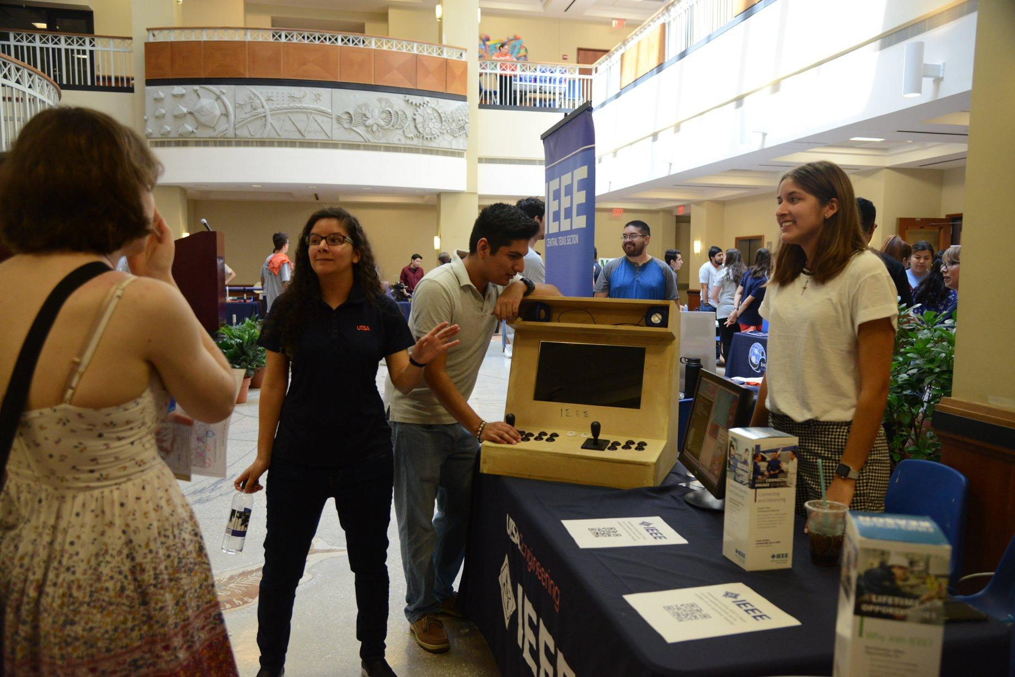
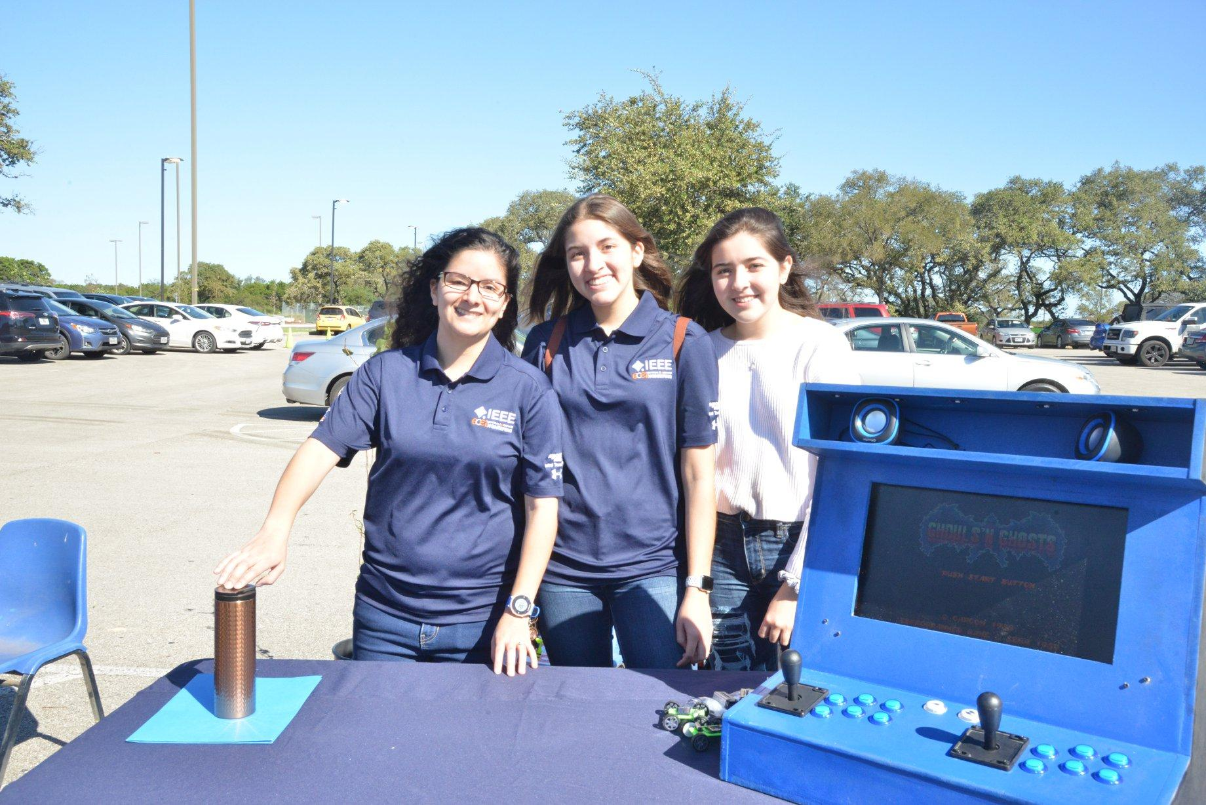
Outreach
Roadrunner Days
Monster Mash Pumpkin Smash

Slide 10
Robotics Student Interest Group [$500]
Current Standing
Primarily focused on Region 5 competition
Robot Arm - Ready
Chassis - Ready
Motor Control - runs well, errors pairing with Ultrasonic
Ultrasonic - runs well, errors pairing with motors
Camera - OpenCV, in the works, edge detection
Workshops
saved for IEEE members in Fall Semesters
Spring Semester workshops only for RAS Members
ROS workshop highly requested again
Working towards Fusion 360 Workshop
Organization
Official UTSA Organization
Working to become an official IEEE National Student Branch
Saving money for tools, parts, registration and travel funds for competitions

Slide 11
HKN Student Interest Group [$200]
Soldering Workshop
18 soldering stations in need of maintenance
Serve 100+ students annually
Industry Speaking Events
Professional Networking
Membership Benefits
Co-hosting two events with Tau Beta Pi
Highschool Outreach
Hosting soldering workshops for 20+ students

Slide 12
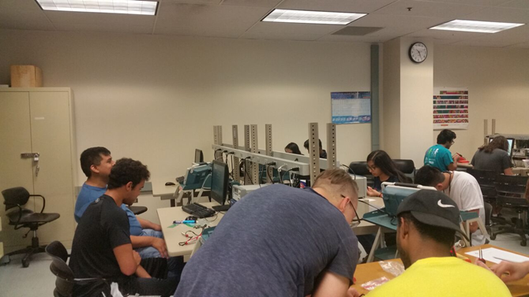
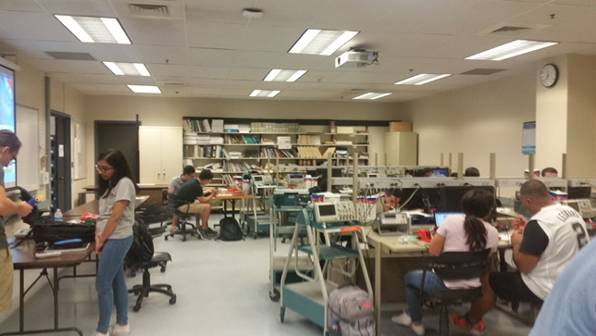
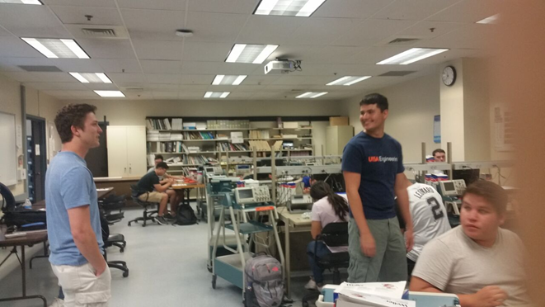
HKN Soldering Workshop

Slide 13
Questions?

